Slide 1
Going Out with a BANG
Zach Sadler – zps6
Andy Beers – acb75

Slide 2


Slide 3


Slide 4


Slide 5


Slide 6


Slide 7


Slide 8
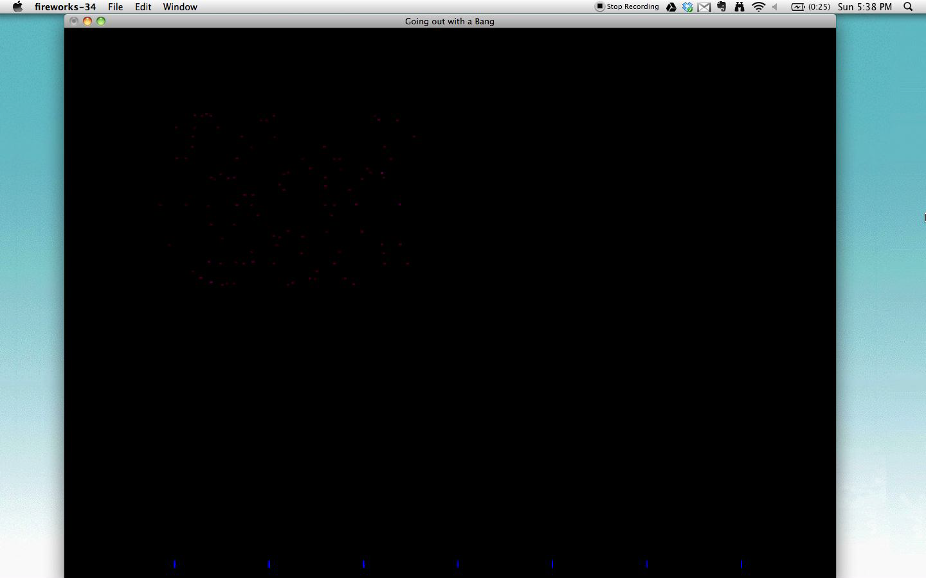

Slide 9


Slide 10


Slide 11


Slide 12
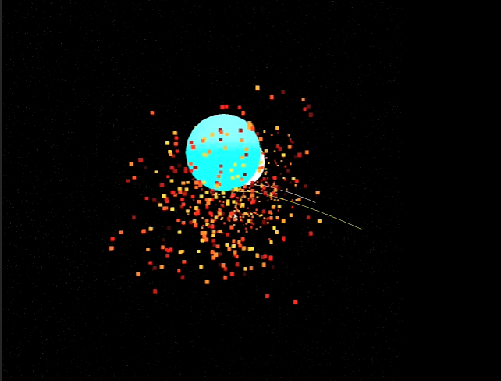
Lukas Hoffman – CS1566 2009

Slide 13
Questions?

